Slide 1
Complaint management System
Groups Member:-
Satyam Singh
Abhay Singh
Aryan Dwivedi

Slide 2
WELCOME

Slide 3
Intoducation
“Complaint Management System” is a web based application which contains data and information of lodge complaints and user details. The main purpose of “Complaint Management System” is to systematically record, store and update the complaints and userrecords.
A Complaint Management System is a software solution designed to handle, track, and resolve customer complaints in an organized and efficient manner. It ensures that all complaints are logged, assigned, monitored, and resolved in a timely manner, leading to improved customer satisfaction and operational efficiency.

Slide 4
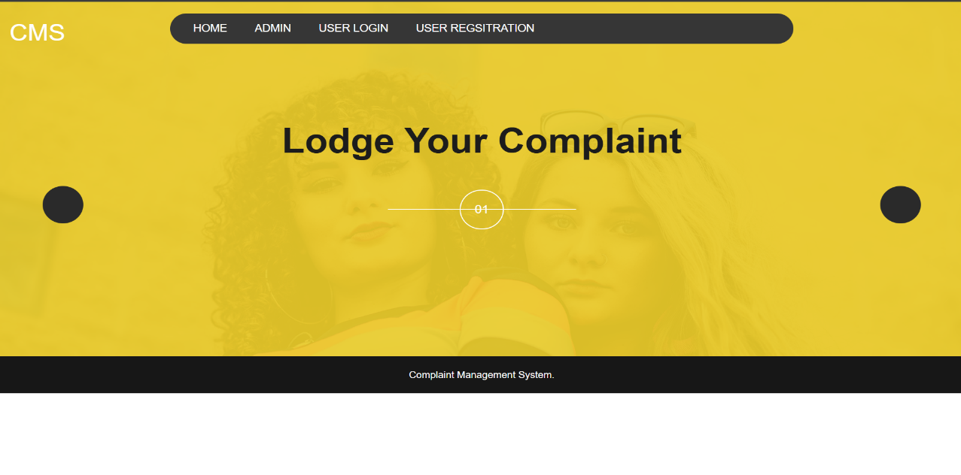
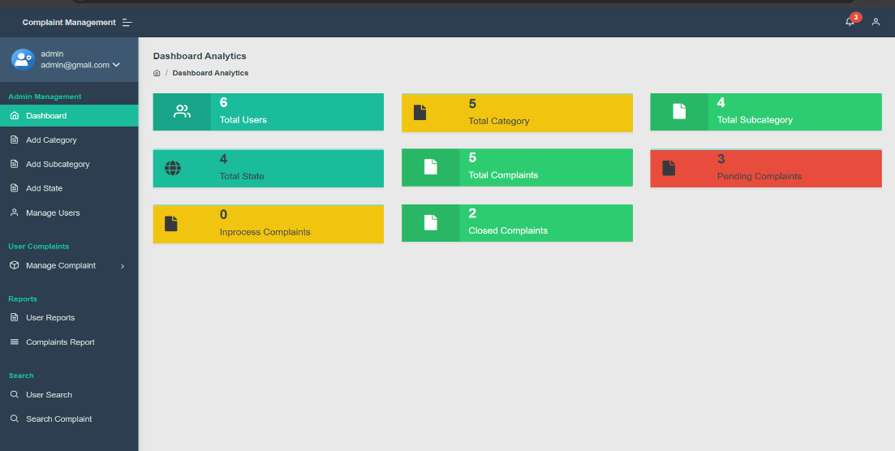
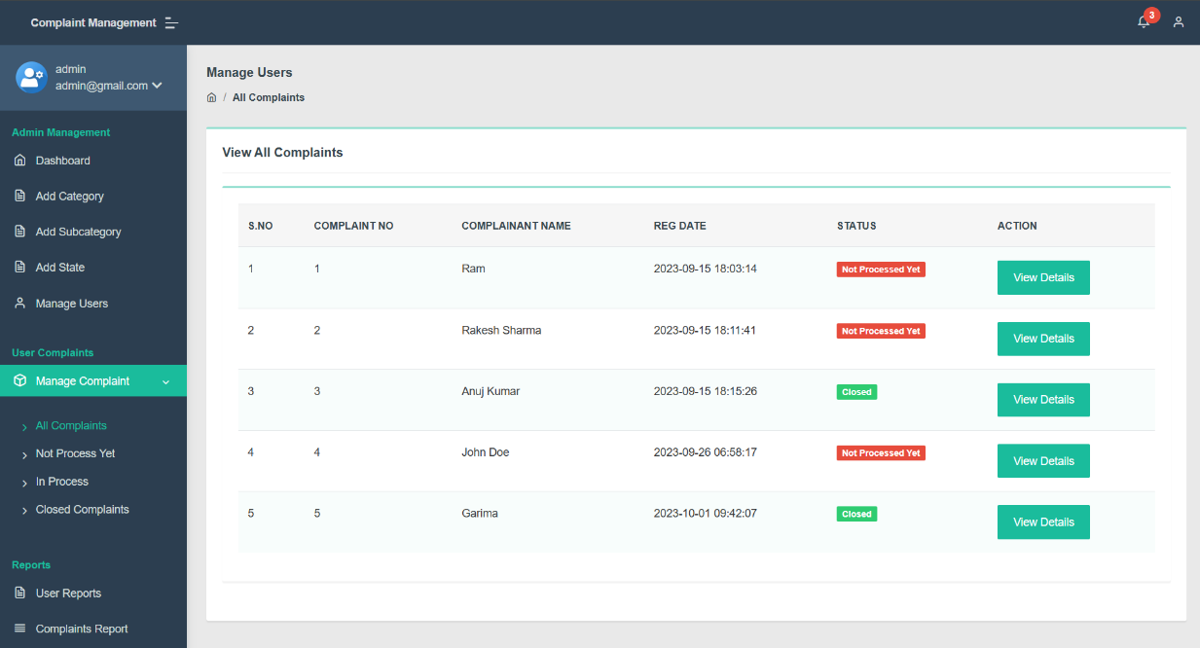
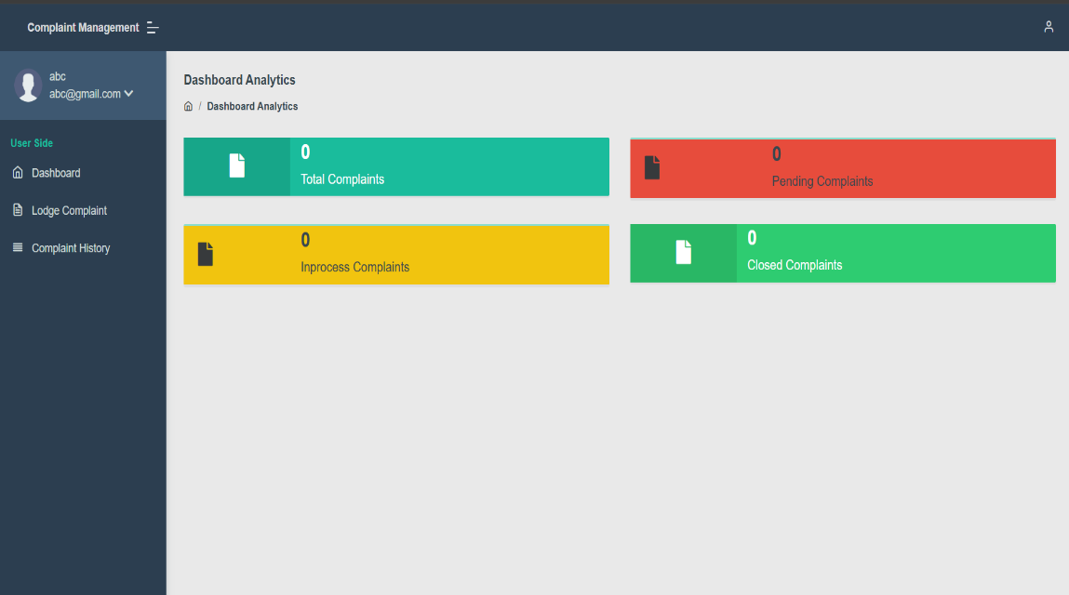
Screenshot
Index Page
Admin Dashboard
Complaint Page
Index Page

Slide 5
Future Scope:-
The future scope of a Complaint Management System (CMS) is vast, especially with advancements in technology and growing demands for efficient customer service across industries. Here are some key areas where CMS can evolve: -
Real-Time Analytics and Reporting
Self-Service Portals.
Integration with AI and Machine Learning.
Mobile Accessibility
Integration with Internet of Things (IoT).

Slide 6
Conclusion
A Complaint Management System (CMS) plays a critical role in ensuring that customer issues are addressed promptly and efficiently, ultimately leading to higher customer satisfaction and loyalty. In today’s competitive market, where customer experience is a key differentiator, having a robust CMS is essential for businesses across all sectors.
Ultimately, an effective CMS helps businesses maintain strong relationships with their customers, resolve issues in a timely manner, and continuously improve service quality. By adopting modern technologies and focusing on customer-centric solutions, businesses can ensure a more seamless and positive experience for their customers while improving overall operational efficiency.

Slide 7

THANK YOU

